Slide 1
Boolean constants and variables

Slide 2
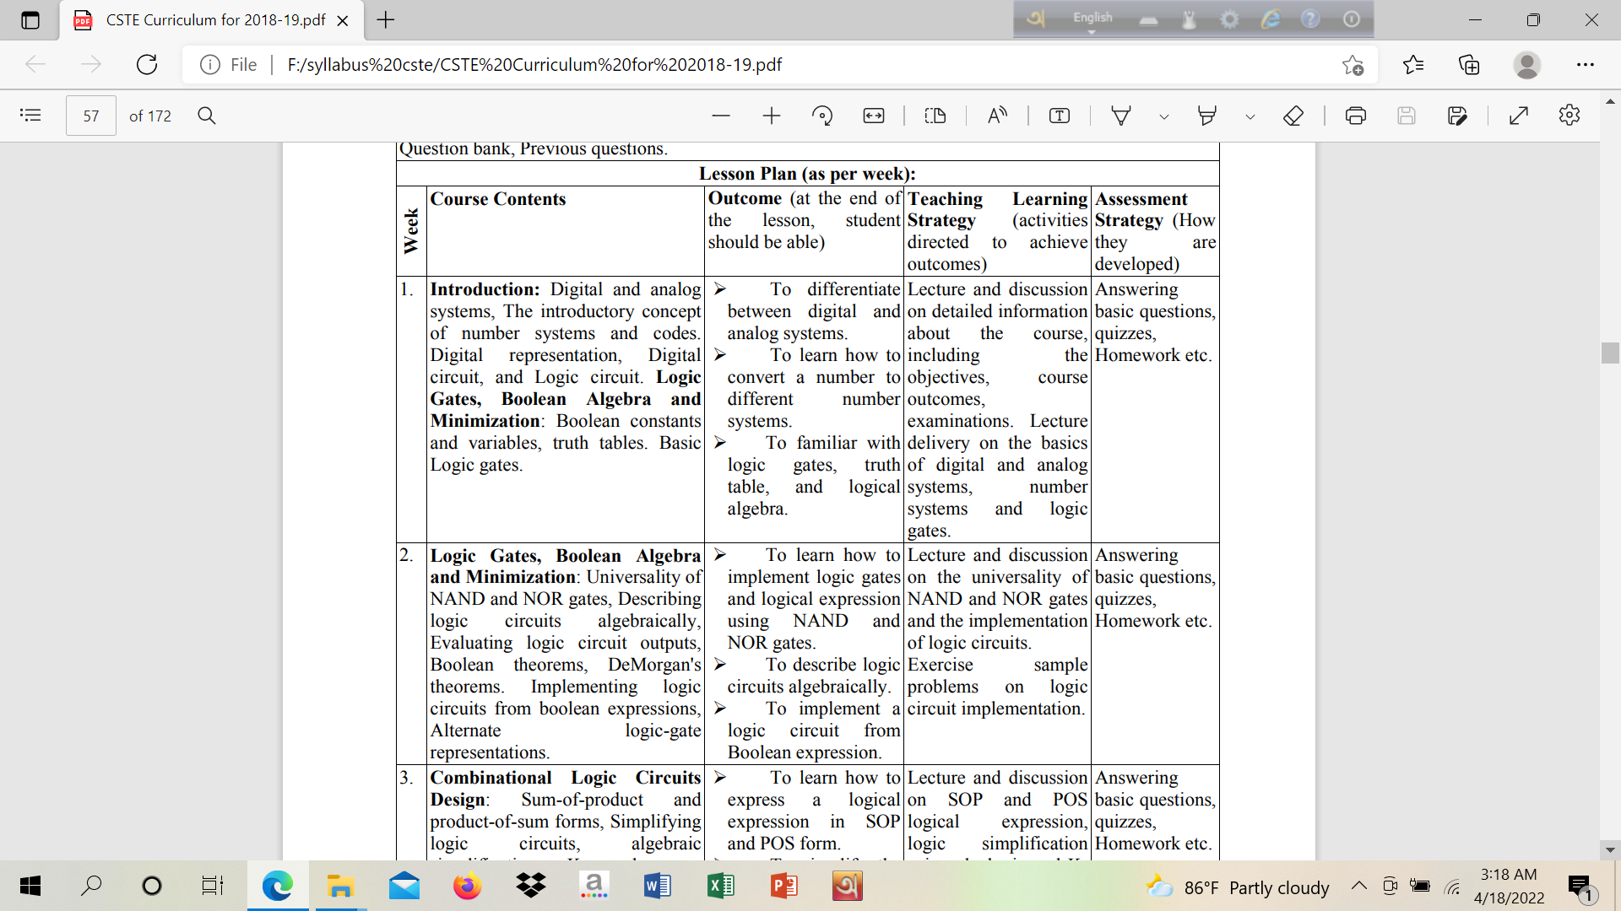

Slide 3
Boolean constants and variables
Boolean constants and variables are allowed to have only two possible values, 0 or 1. Example: In a certain digital system, Boolean value 0 might be assigned to the voltage range 0-0.8V, while the Boolean value of 1 might be assigned to 2-5V.
Boolean 0 and 1 do not represent actual numbers but represent voltage variable or logic level.
Logic 0 | Logic 1
False | True
Off | On
Low | High
No | Yes
Open switch | Closed switch

Slide 4
Boolean algebra
Boolean algebra is a means for expressing the relationship between a logic circuit’s inputs and outputs. In Boolean algebra, there are no fractions, decimals, negative numbers, square root, cube roots, logarithms, imaginary numbers and so on.
In Boolean algebra there are three basic operations: OR, AND and NOT. These operations are called logic operations. Digital circuits are called logic gates. Logic gates can be constructed from diodes, transistors and resistors.

Slide 5
Truth table
Truth table describes how a logic circuits output depends on the logic level present at the circuit’s input.
Example: Two input logic circuit.
A | B | x
0 | 0 | 1
0 | 1 | 0
1 | 0 | 1
1 | 1 | 0

Slide 6
Truth table
Following Table shows the three input circuit. The number of input combinations will equal to 2^{N} for an N input truth table.
A | B | C | x
0 | 0 | 0 | 0
0 | 0 | 1 | 1
0 | 1 | 0 | 1
0 | 1 | 1 | 0
1 | 0 | 0 | 0
1 | 0 | 1 | 0
1 | 1 | 0 | 0
1 | 1 | 1 | 1

Slide 7
Or operation with or gates
Boolean expression for OR operation is
x= A+B (two input)
x=A+B+C (three input)
Example: Kitchen oven: When the light inside the oven should turn on???
Depends on either light switch (A) turn on/off, or door (B) opened/closed.
A | B | X=A+B
0 | 0 | 0
0 | 1 | 1
1 | 0 | 1
1 | 1 | 1

Slide 8
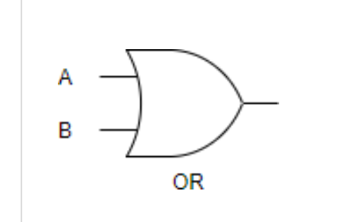
Or gate
A+B

Slide 9
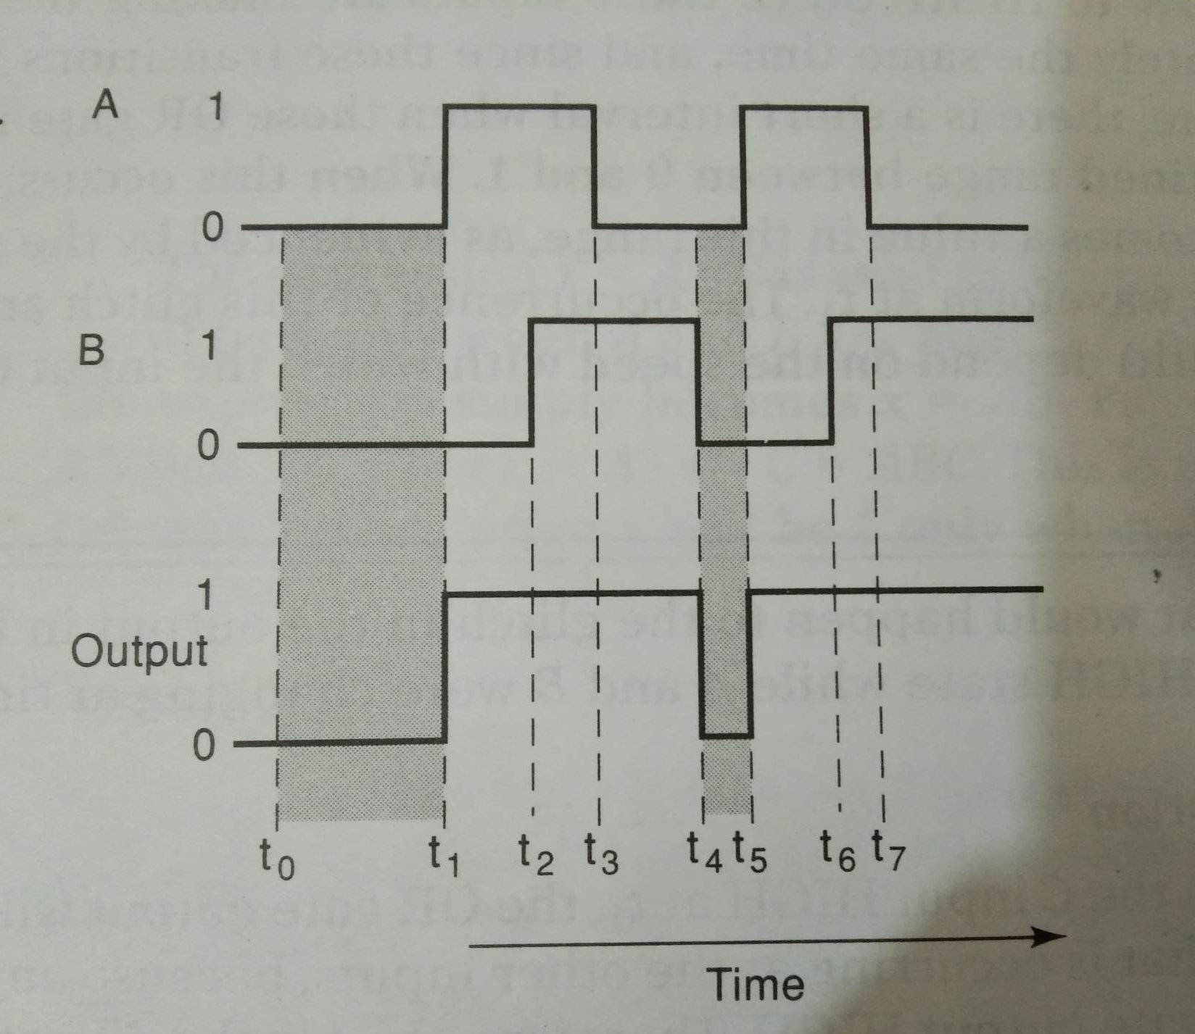
Determine or gate output from the following waveform

Slide 10
Summary of or operation
OR operation produces output 1 whenever any input is 1. Otherwise the output is 0.
OR gate is a logic circuit that performs an OR operation on the circuit’s input.
Expression x=A+B is read as “ x equals A OR B”

Slide 11
Question
What is the only set of input conditions that will produce a LOW output for any OR gate?

Slide 12
and operation with and gates
Boolean expression for AND operation is
x= A . B (two input)
x=A.B.C (three input)
Example: Clothes dryer: heating and tumbling only if the timer (A) is set above zero and the door (B) is closed.
A | B | X=A.B
0 | 0 | 0
0 | 1 | 0
1 | 0 | 0
1 | 1 | 1

Slide 13
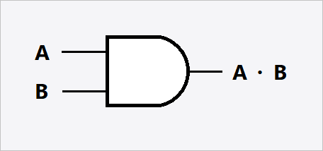
ANd gate

Slide 14
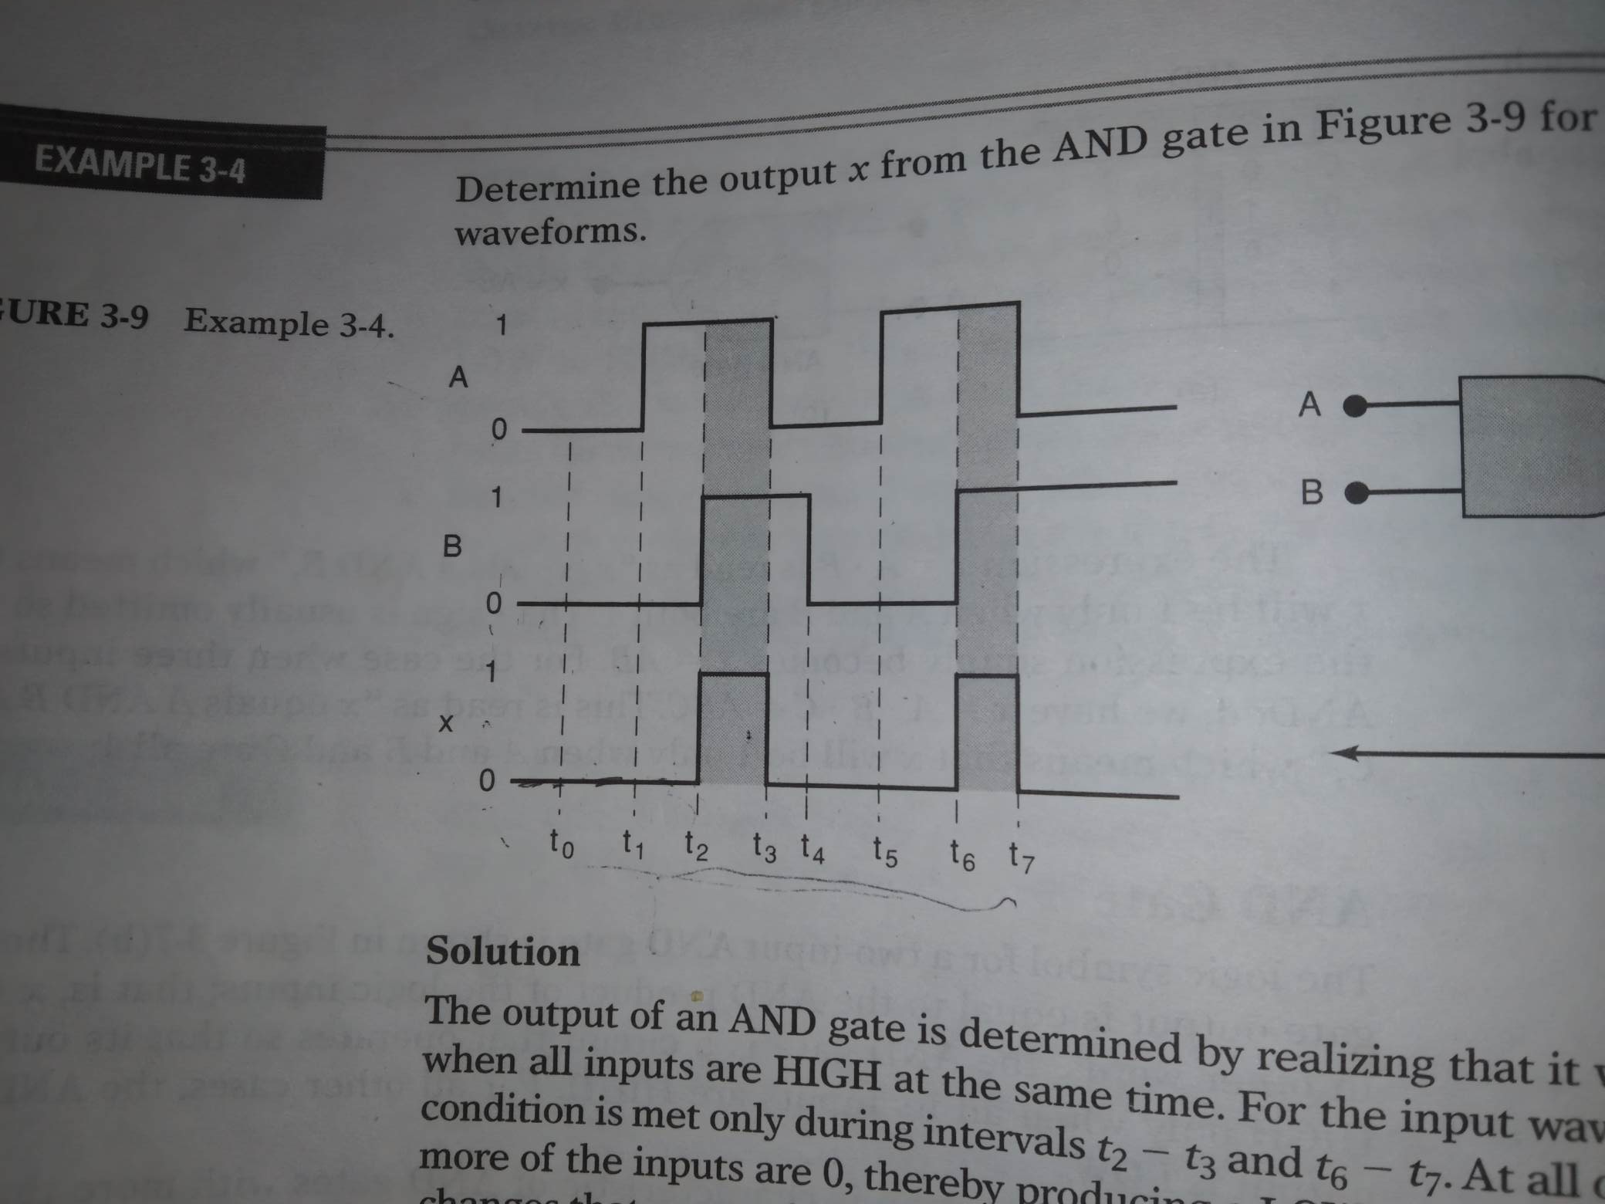
Determine AND gate output from the following waveform

Slide 15
Summary of and operation
AND operation is performed the same as ordinary multiplication of 1s and 0s.
AND gate is a logic circuit that performs the AND operation on the circuit’s inputs.
An AND gate output will be 1 only for the case when all inputs are 1; for all other cases, the output will be 0.
Expression x=A.B is read as “ x equals A AND B”

Slide 16
Question
What is the only input combination that will produce a HIGH at the output for a five-input AND gate?

Slide 17
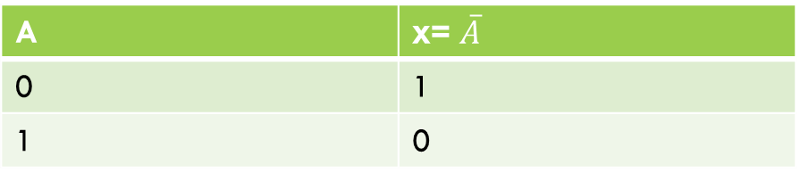

Not operation with not gate
Unlike OR and AND operation. It can perform on a single input variable. If the variable A is subjected to the NOT operation, the result x can be expressed as
x= $\overline{A}$
A’= $\overline{A}$
X equals NOT A / inverse of A / complement of A
A | x= $\overline{A}$
0 | 1
1 | 0

Slide 18
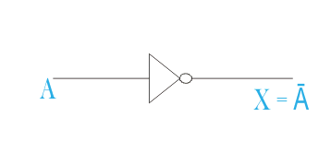
NOT gate

Slide 19
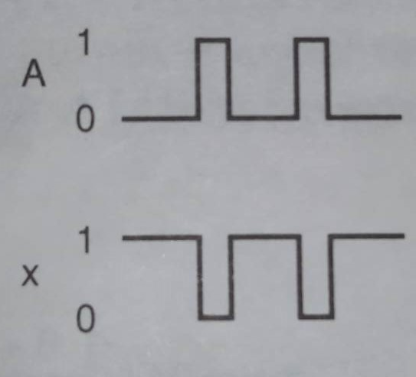
Determine not gate output from the following waveform

Slide 20
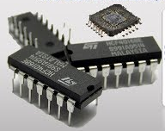
Integrated circuit containing AND, OR, NOT gates
integrated circuit (IC), also called microelectronic circuit, microchip, or chip, an assembly of electronic components, fabricated as a single unit, in which miniaturized active devices (e.g., transistors and diodes) and passive devices (e.g., capacitors and resistors) and their interconnections are built upon a thin substrate of semiconductor material (typically silicon).

Slide 21
IC numbers (TTL)
74LS32
74LS08
74LS04
The 74LS family of ICs is a lower-power version of the 74S family, with slightly higher speed but lower power dissipation than the original 74 family; it became the most popular variant once it was widely available. Many 74LS ICs can be found in microcomputers and digital consumer electronics manufactured in the 1980s and early 1990s.

Slide 22
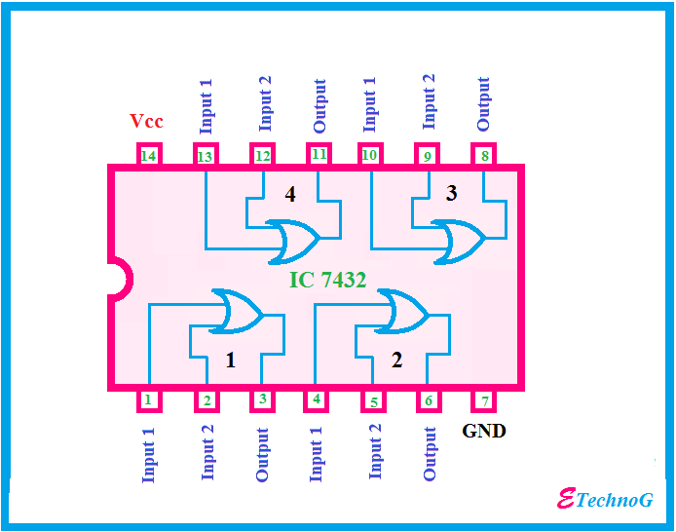
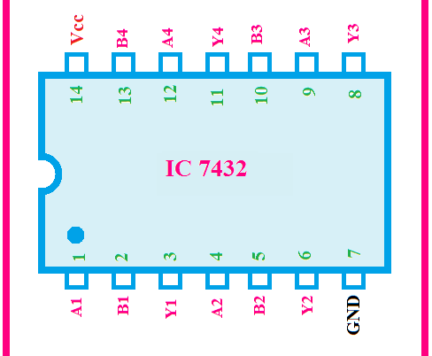
OR gates 74LS32
The 74LS32 is a Dual Input OR Gate with Quad package. It contains four independent gates each of which performs the logic OR function. Each gate has two inputs that's why it is named Quad 2-Input OR Gate. It has 12 input output pins for a total of four OR gates.

Slide 23
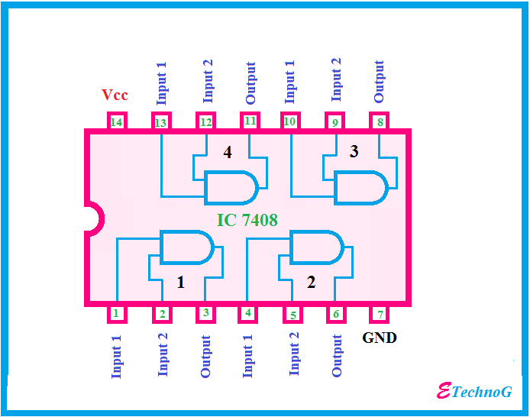
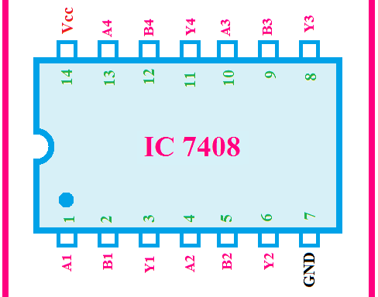
AND gates 74LS08
74LS08 IC contains four AND gates in the chip and each gate have two inputs, hence the name QUADRUPLE 2- INPUT AND GATE. The gates in the chip are designed by SCHOTTKY TRANSISTORS for high speed logic operations.

Slide 24
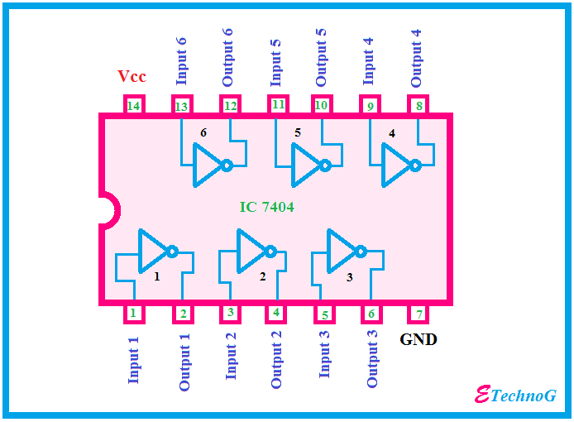
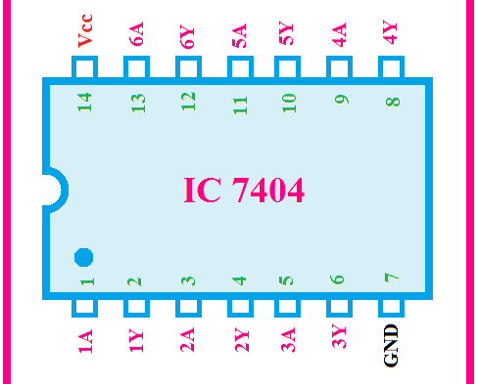
NOT gates 74LS04
74LS04 IC contains six NOT gates in the chip and each gate have 1 input.

Slide 25
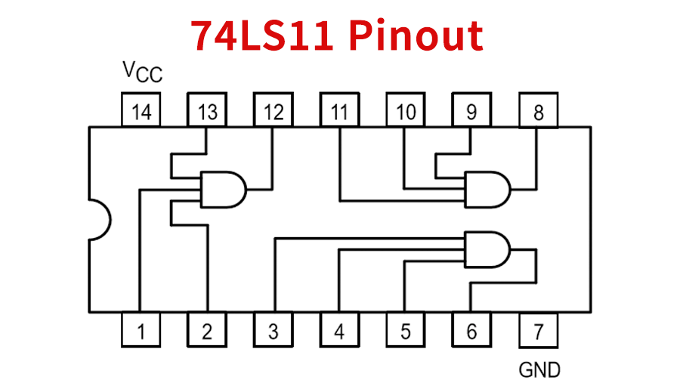
3 input AND gates 74LS11

Slide 26
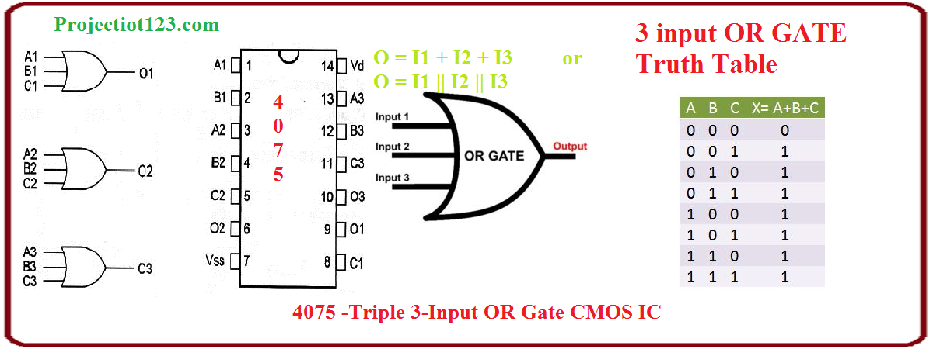
3 input OR gates 4075 CMOS IC

Slide 27
note
TTL circuits utilize BJTs while CMOS circuits utilize FETs.
CMOS allows a much higher density of logic functions in a single chip compared to TTL.
TTL circuits consumes more power compared to CMOS circuits at rest.
CMOS chips are a lot more susceptible to static discharge compared to TTL chips.
There are CMOS chips that have TTL logic and are meant as replacements for TTL chips.

Slide 28
Describing logic circuit algebraically

Slide 29
Describing logic circuit algebraically
Any logic circuit, no matter how complex, can be described completely using three basic Boolean operations because the OR, AND and NOT circuit are the basic building blocks of digital systems.
The circuit in the following slide, utilize Boolean expression for each gate.

Slide 30
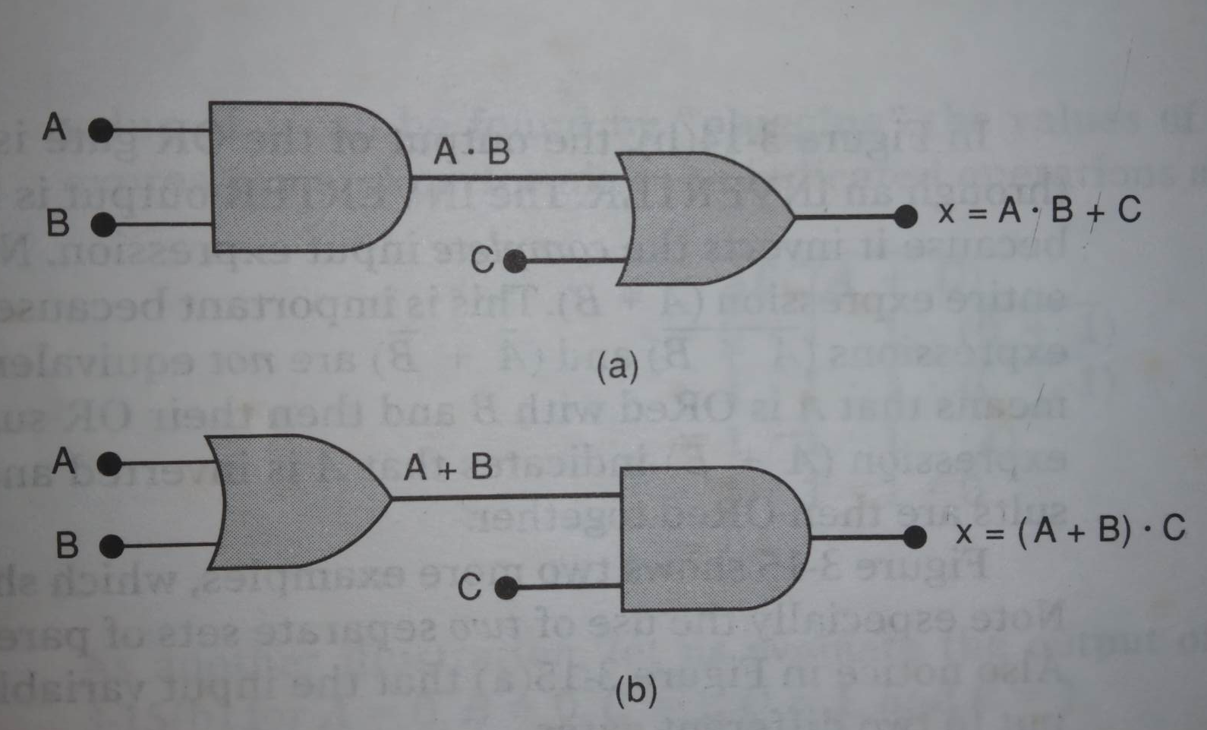
Describing logic circuit algebraically
Input A, B, C
Output x
1. Without first brackets/parentheses: AND operation first.
2. With first brackets/ parentheses indicate the first operation here.

Slide 31
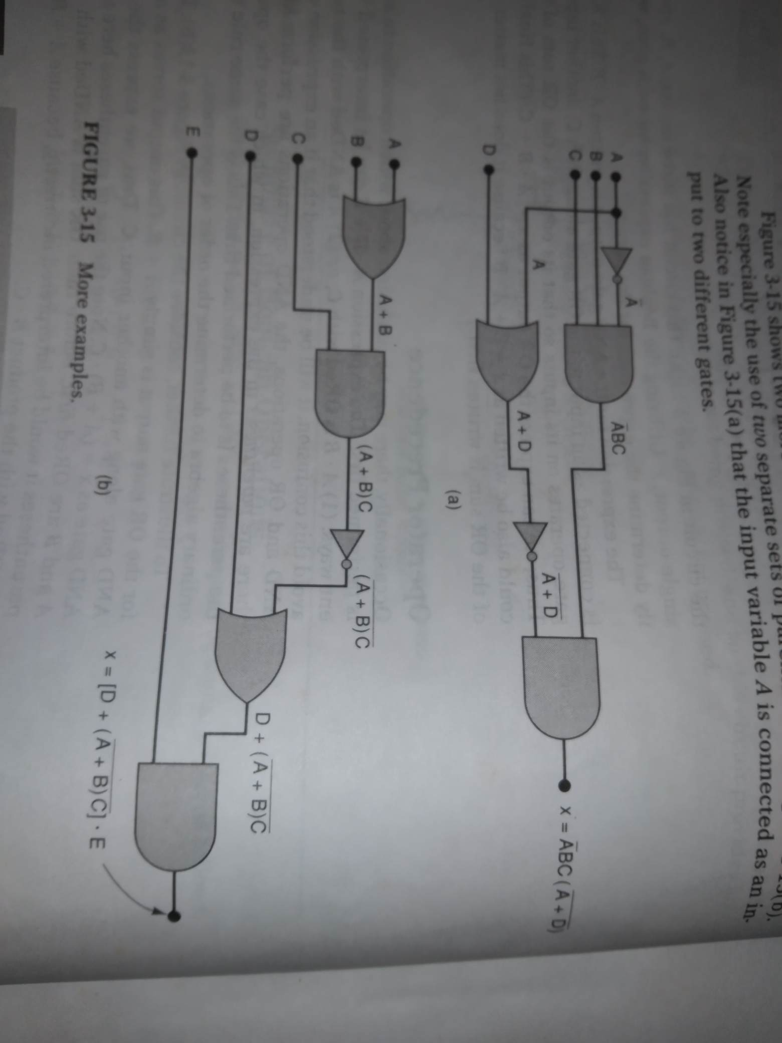
Circuit containing Inverters

Slide 32
Circuit containing inverters

Slide 33
Circuit containing inverters
$$x=\overline{A}BC(\overline{A+D})$$
Input variable A is common to two different gates.

Slide 34
Circuit containing inverters
$$x=\left[D+\overline{\left(A+B\right)C}\right].E$$
Use of two separate sets of parentheses here.

